Slide 1
MedEase
A Blockchain-Based Medical Web Application
Final Presentation 499A
Team Members:
Chowdhury Nafis Faiyaz
ID: 1931841642
Ayman Ibne Hakim
ID: 2013364042

Slide 2
What is MedEase?
Blockchain based Centralized Healthcare application
Revolutionize healthcare with our cutting-edge blockchain-based medical web application.
This platform will securely store patients' medical records, treatment histories, and diagnostic reports on a tamper-proof blockchain, ensuring data integrity and privacy.
The decentralized nature of the blockchain guarantees that medical data remains under patients' control, enhancing trust and compliance with data regulations.
Patients can seamlessly grant healthcare providers access to their records, streamlining the treatment process and reducing administrative hurdles.
Patients can interact with doctors and take treatment without the hassle of in person meetups
Doctors can access patient reports, medical history and health information with ease.

Slide 3
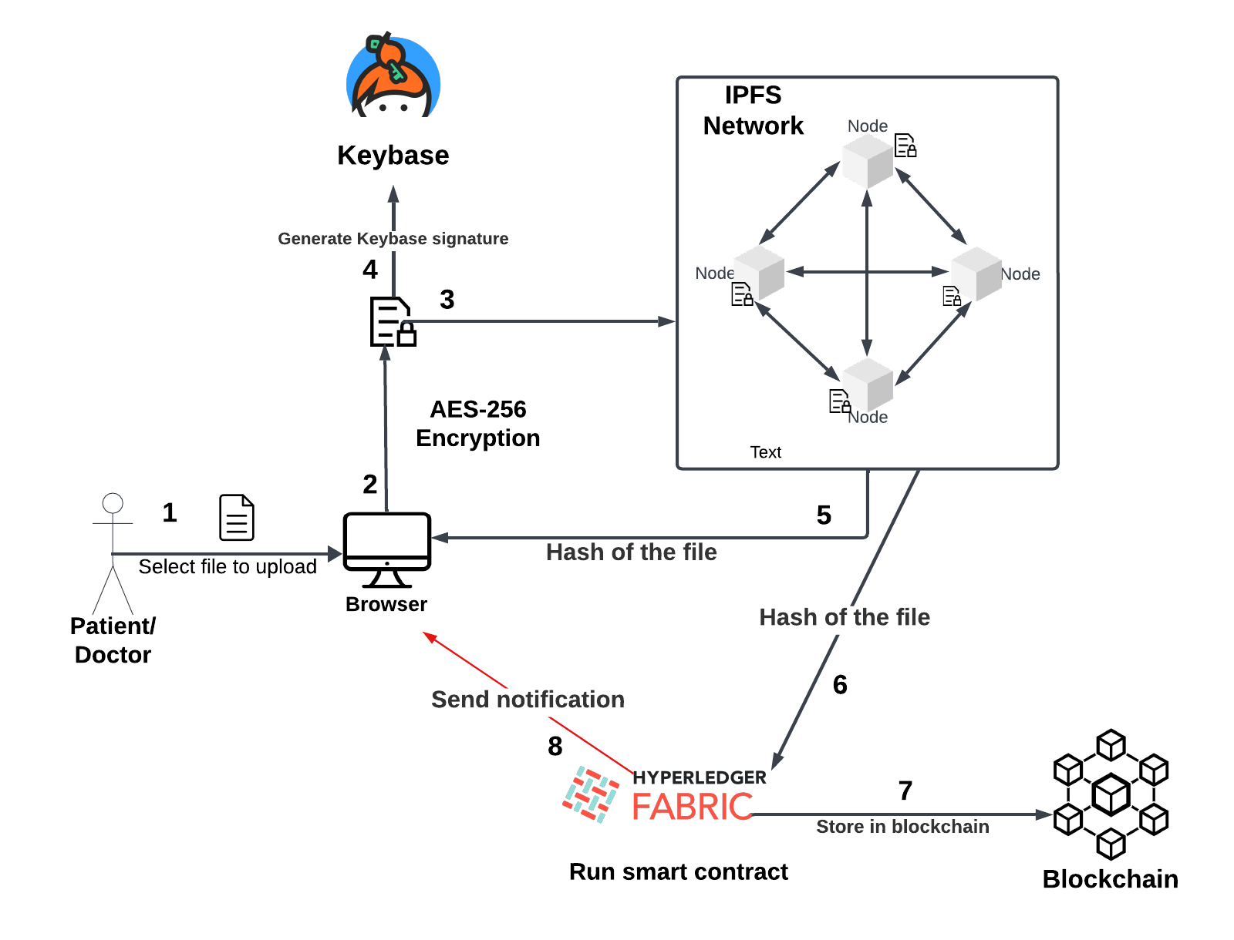
Design: How do we use blockchain for file storage?
In our proposed system, we plan to combine several technologies to create a secure and decentralized infrastructure for managing files and encryption keys:
Hyperledger Fabric: This is the foundation of our private blockchain network. It's a permissioned blockchain platform designed for enterprise applications. Only authorized nodes can participate, ensuring security and control.
IPFS (InterPlanetary File System): We'll use IPFS to store files in a decentralized manner. IPFS operates through a peer-to-peer network, making it resilient and efficient for file storage and sharing.
Keybase: Keybase serves as the platform for verifying online identities and securely sharing encrypted files and messages. Users link their online identities to a public key, and encryption keys for files will be stored in Keybase. Doctors can request these keys from the patient to access the files.

Slide 4
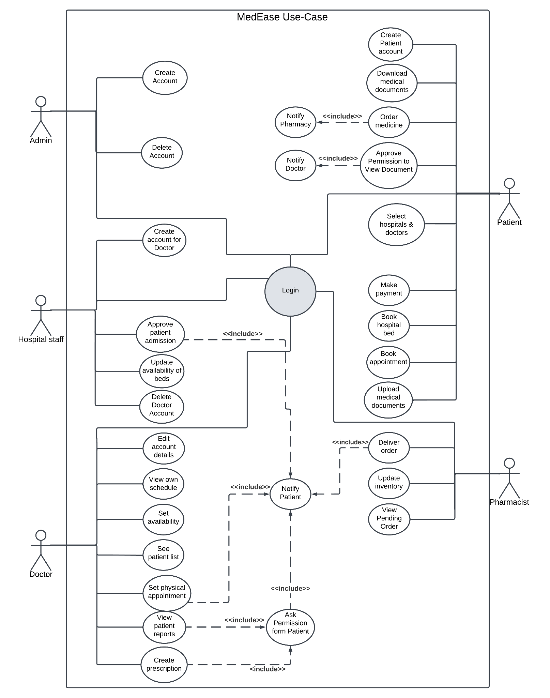
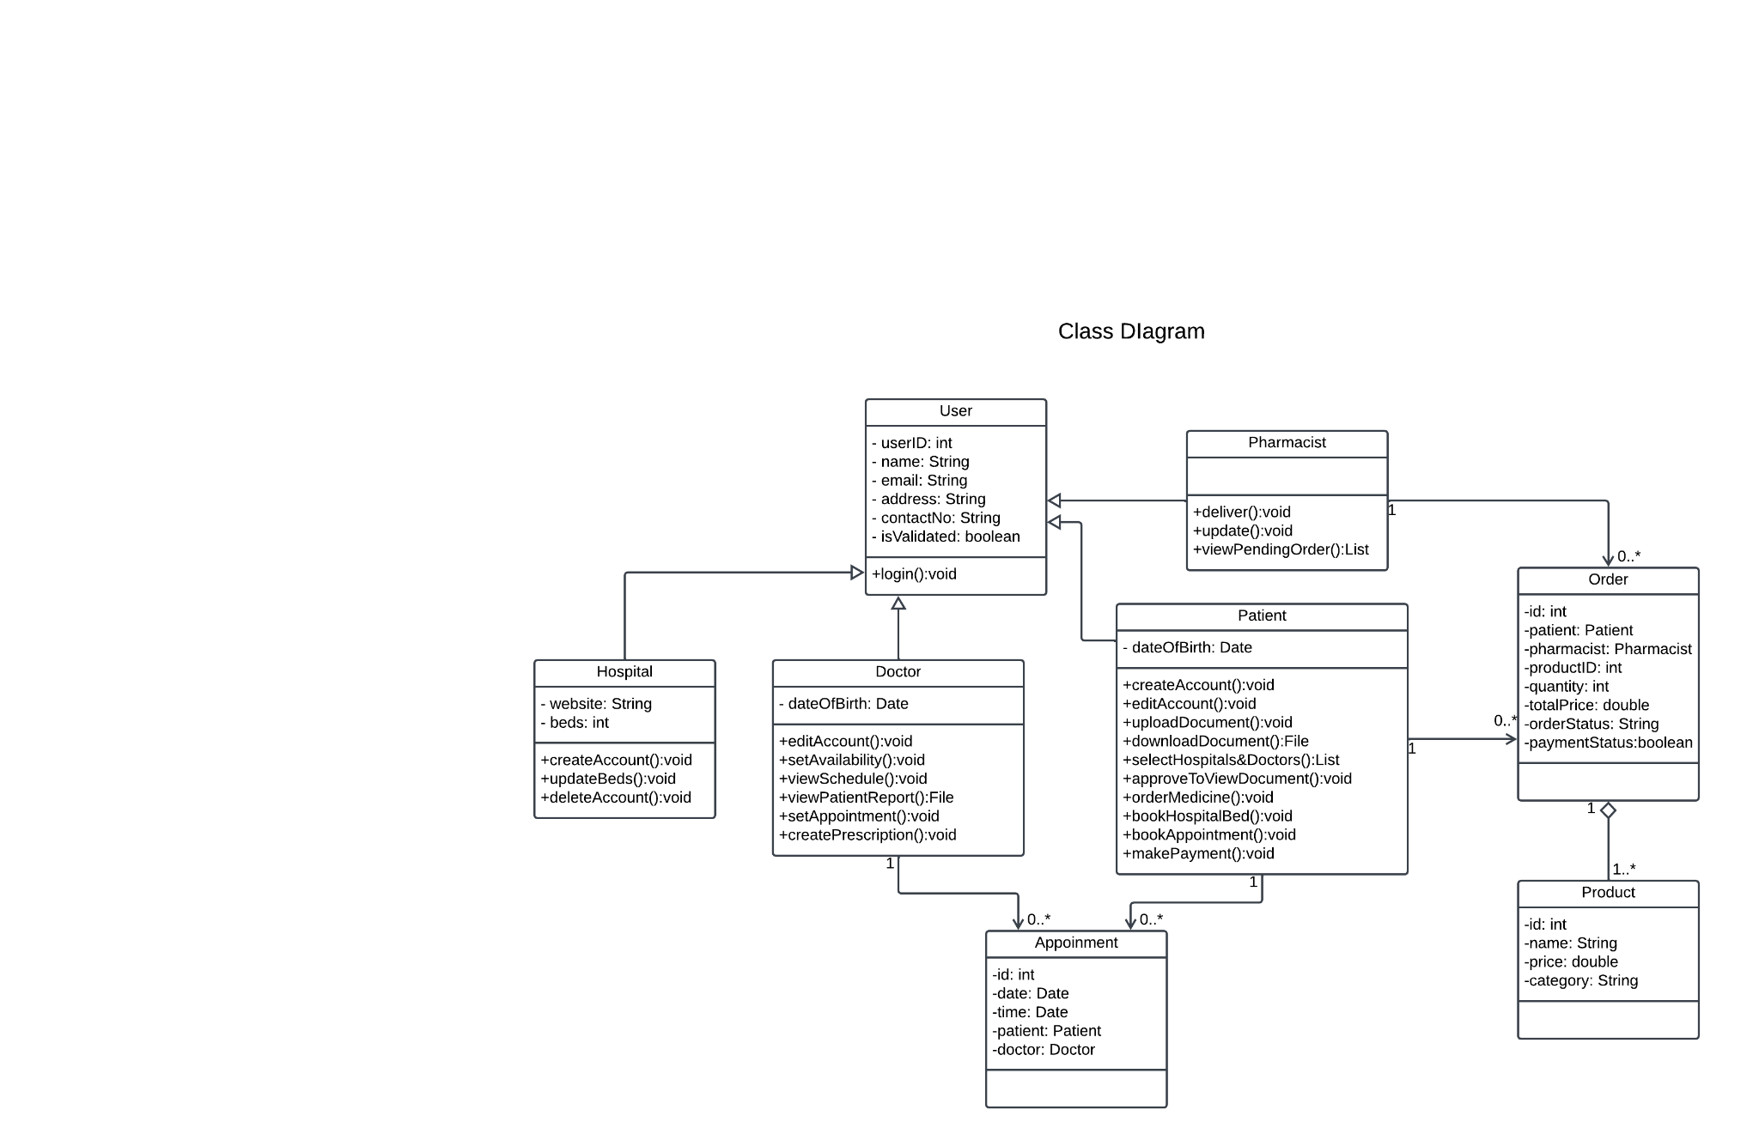
Design: Class and Use-Case diagram

Slide 5
Environmental and social effects
Environmental and Health Effects:
Reduced Paper Usage
Energy Consumption
E-Waste Generation
Data Centers' Carbon Footprint
Accessible Health care facility
Social Effects:
Improved Patient Care
Enhanced Efficiency
Data Security and Privacy
Access Disparities
Workforce Impact
Ethical Considerations

Slide 6
Ethical and professional Responsibility
Ethical and Professional Responsibility:
Principle 1.2: Avoid Harm.
Principle 1.6: Respect Privacy.
Principle 1.7: Honor Confidentiality.
Principle 2.1: Strive to achieve high quality in both the processes and products of professional
Principle 2.4: Communicate professionally and honestly with others.
Principle 2.5: Consider potential impacts of computing work on society.
Principle 2.9: Design and implement systems that are robustly and usably secure.

Slide 7






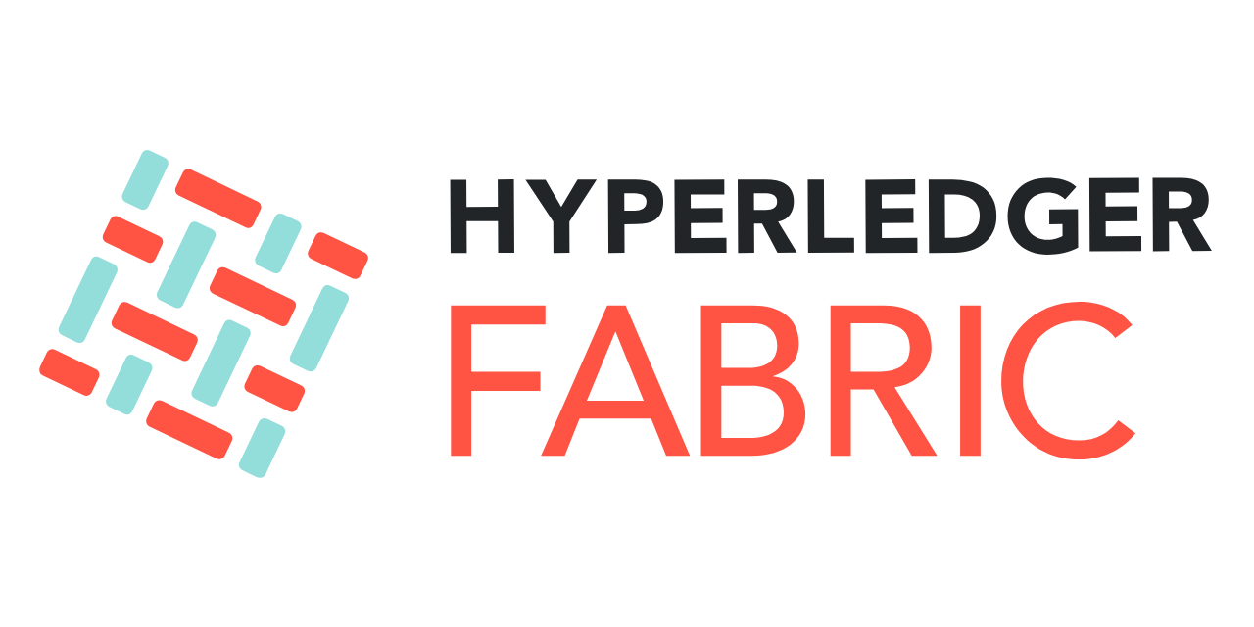
Tech Stack
Front End
Back End
Keybase SDK

Slide 8
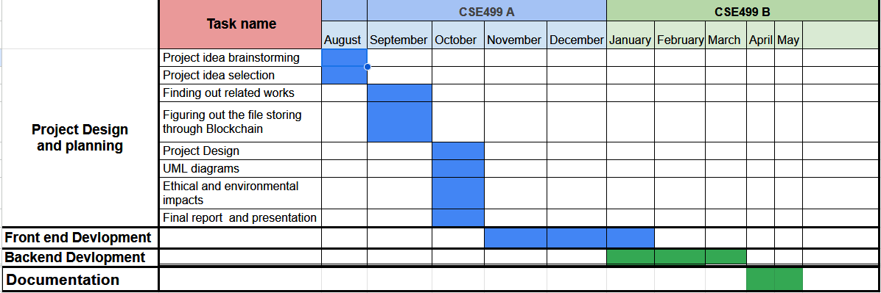
Proposed Working plan and Results

